Slide 1
Precise Epidemic Control Based on GeoHash

Slide 2
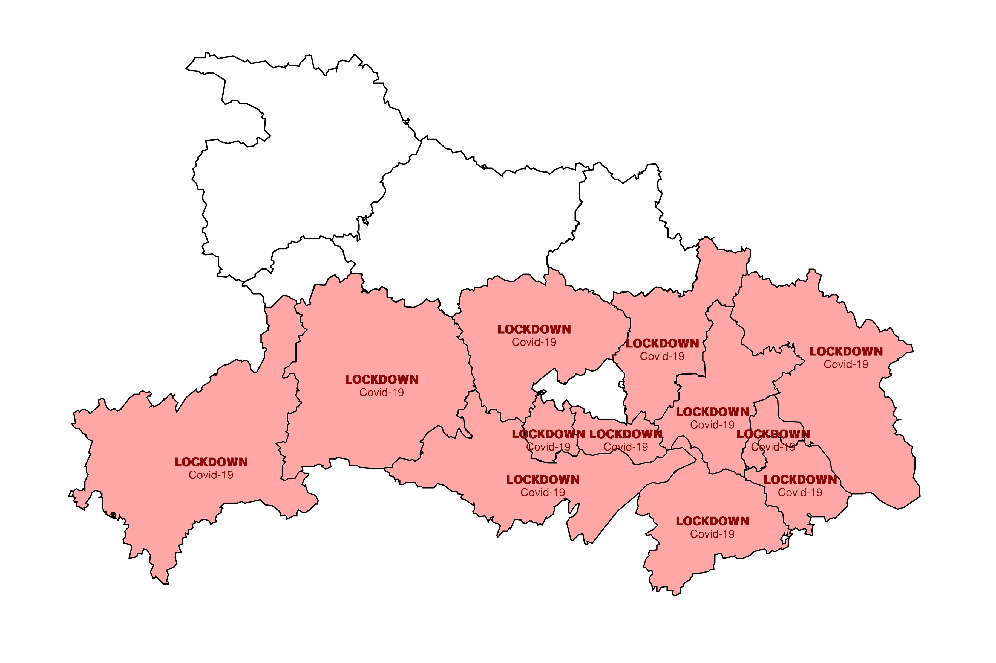
Motivation
1) The border of a city is irregular while the transmission of virus doesn’t follow the administrative division.
2) The administrative range of a region is constant, but the disease is spreadable, thus the lockdown areas are not expandable flexibly.
3) Due to policy differences in different regions, information release is not complete and coincident.
4) The news released by the local government may lag behind, thus it is difficult for residents to obtain the news in real time.
5) A complete lockdown can lead to huge social and economic losses.

Slide 3
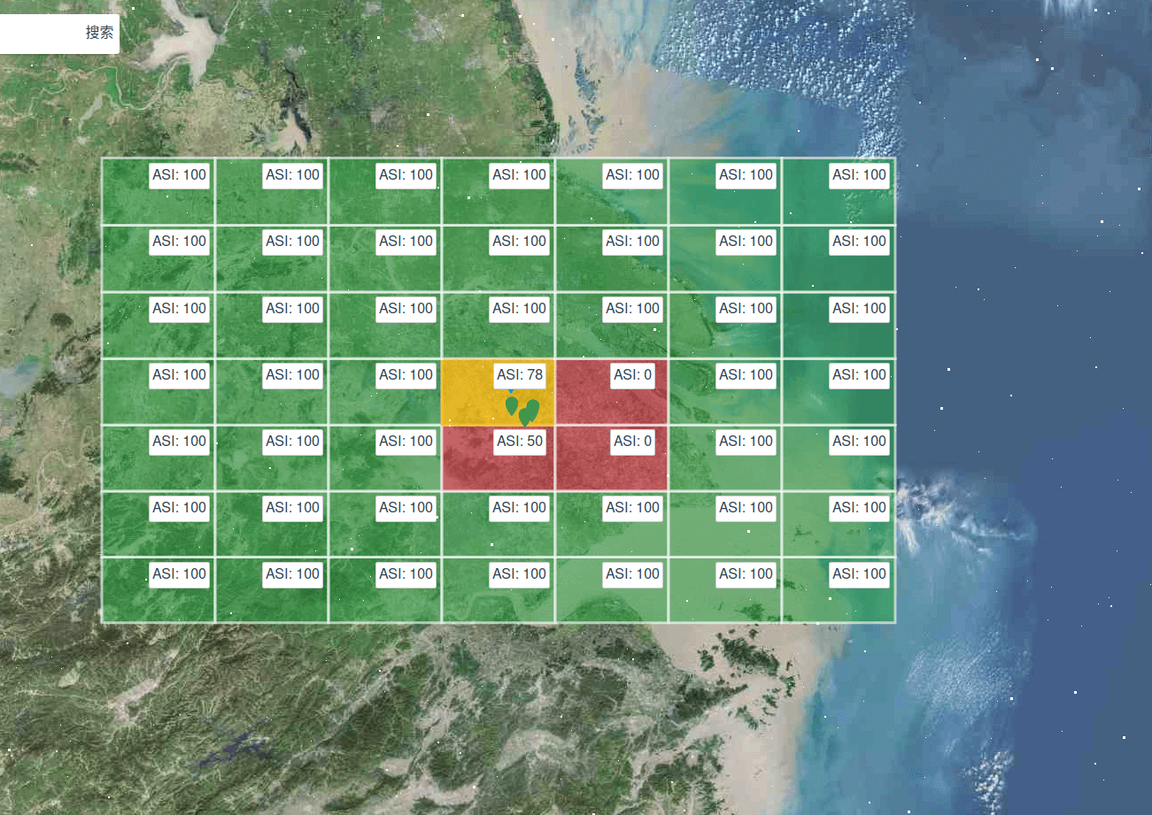
Overview
The core idea of our research is to divide the earth into several connected dynamic blocks (grids) and the blocks have the following characteristics:
The blocks divided by GeoHash are regular geometry, the shape can be customized by observers.
The blocks are generated dynamically, and they are scale-able according to the scope of infection.
Information of the epidemic can be encoded in GeoHash or directly saved.
The data in a block can be used to analyze through specific algorithms related to medical control.
Users get epidemic information in their block in real time when such a GIS is released to the Internet.

Slide 4
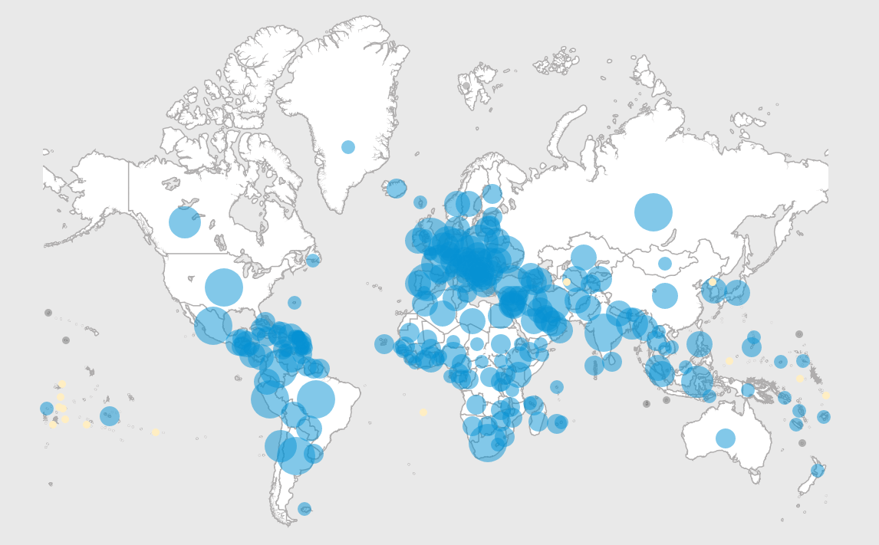
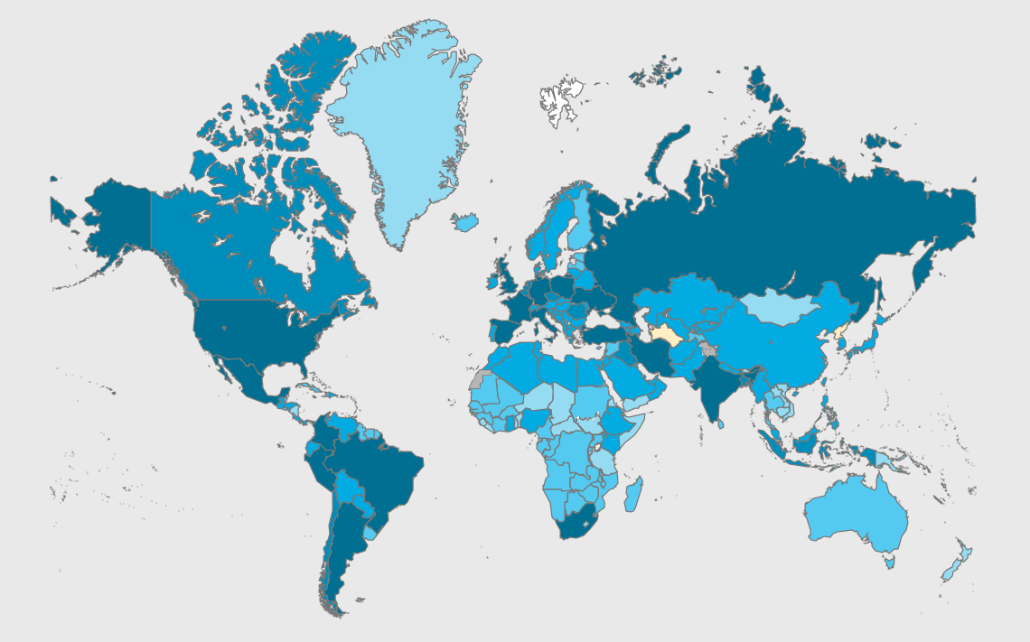
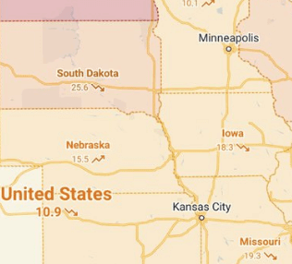
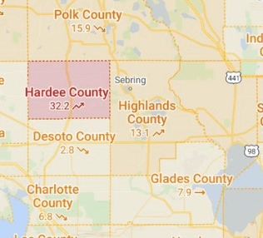
Related Work
The main functions of these software systems are listed as follows
Tracking of people’s movements.
Early warning of high-risk areas.
Screening of asymptomatic potential infections.
Drug development.
Information release and policy support.

Slide 5
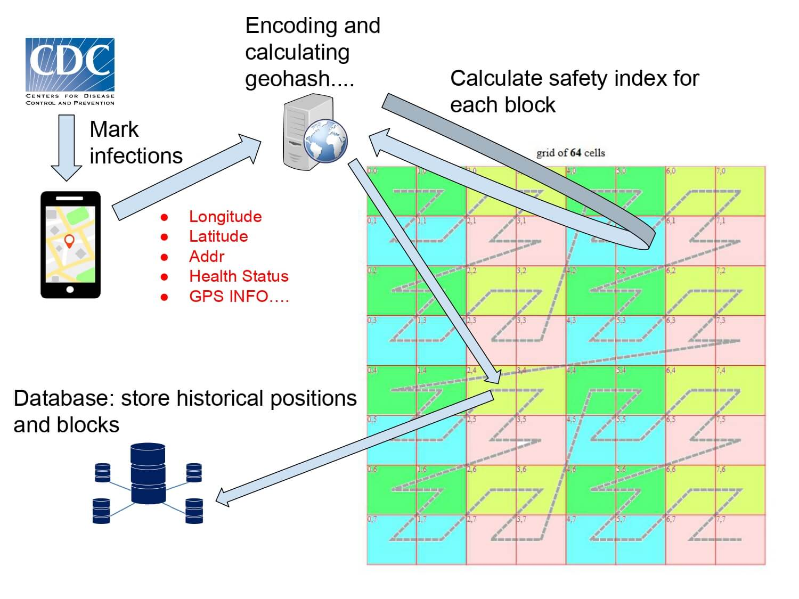
Approach
Our challenges are mainly from two aspects: data collection and data quantification.
Although data collection has been integrated into GIS, it requires the user to authorize GPS on the device to obtain and upload locations to our service.
Quantitative analysis of data is a more complex process and our work is to quantify the collected messy data in each GeoHash block.

Slide 6
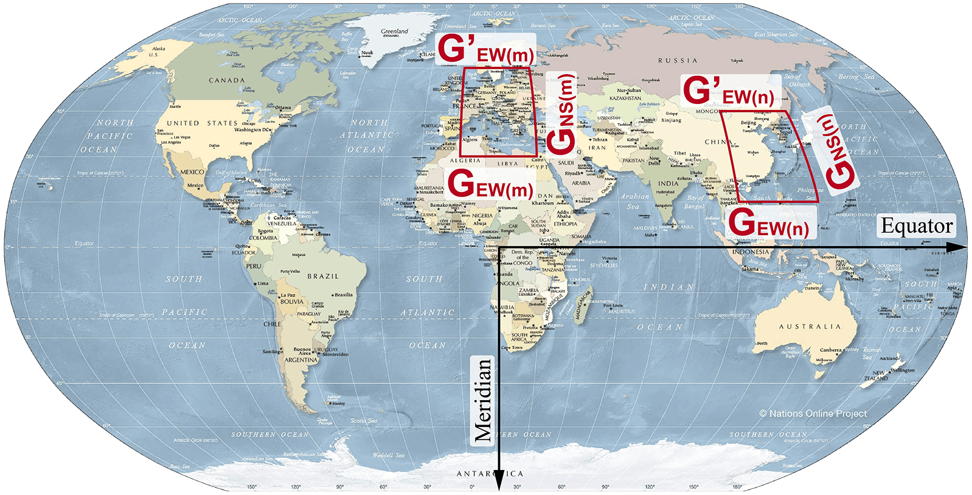
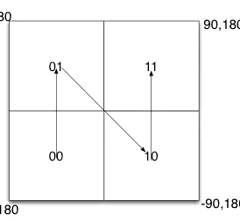
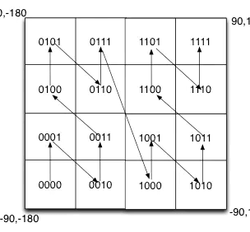
GeoHash

Slide 7
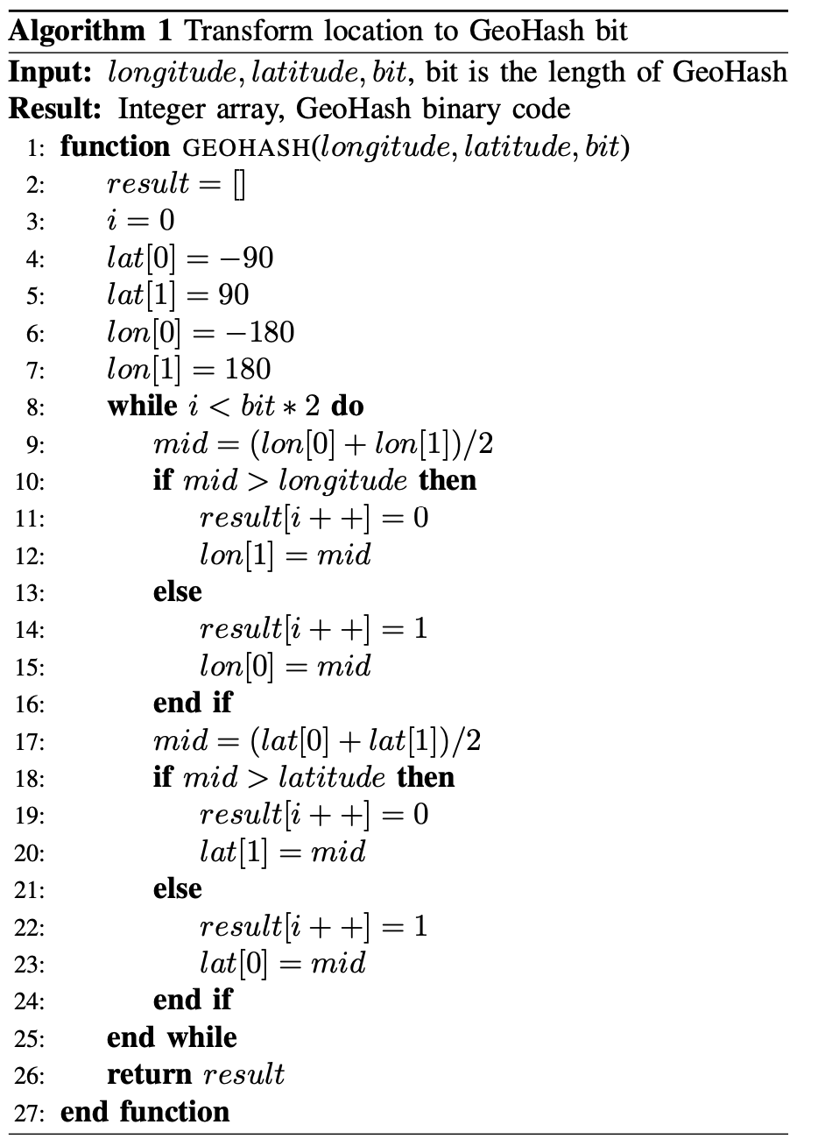
Algorithm

Slide 8
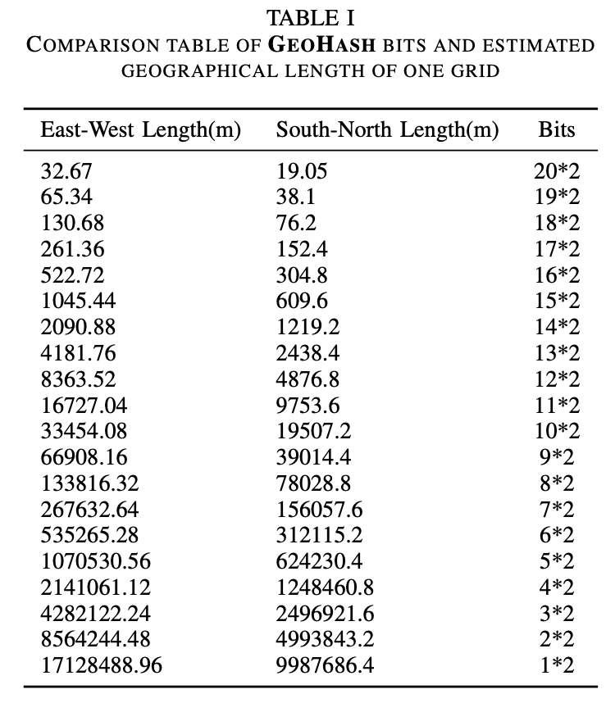
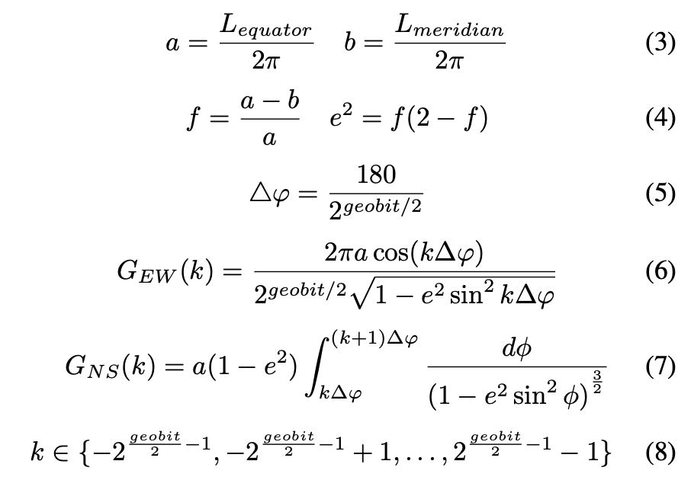
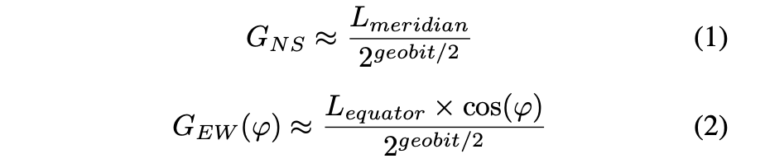
Grids
Elliptical earth (complex)
Spherical earth (simple)

Slide 9
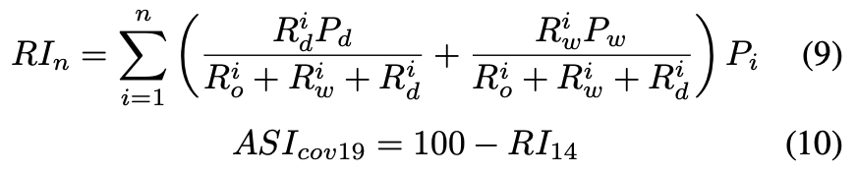
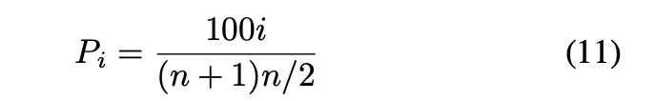
ASI
The sample of quantitative analysis in our research is to obtain a value of ASI (Area Safety Index).
ASI is one of the most important indexes in our research, which reflects the safety degree of a GeoHash block

Slide 10
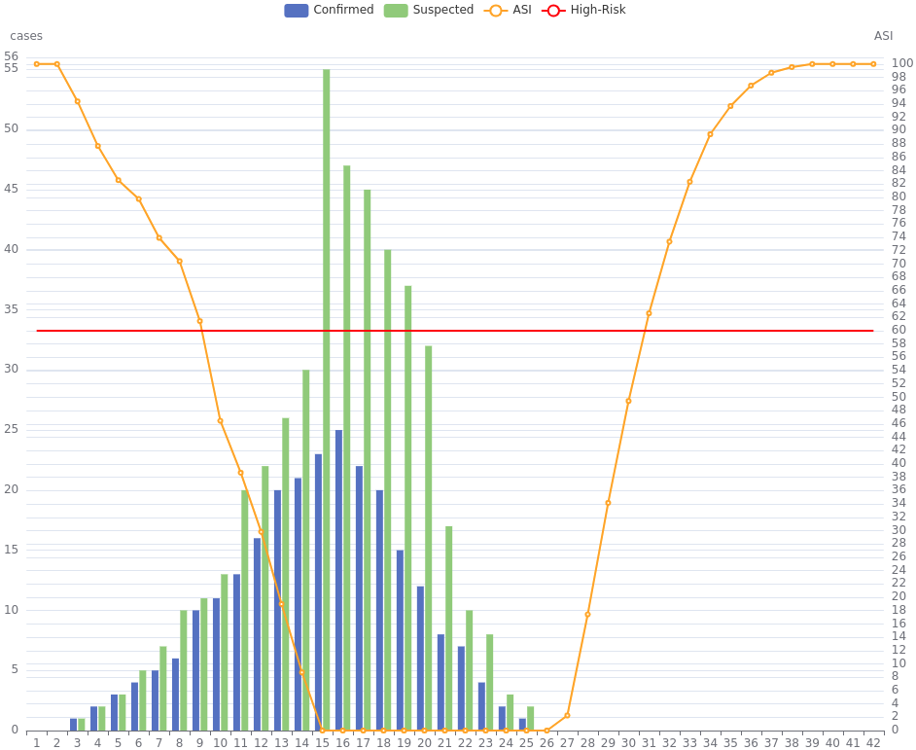
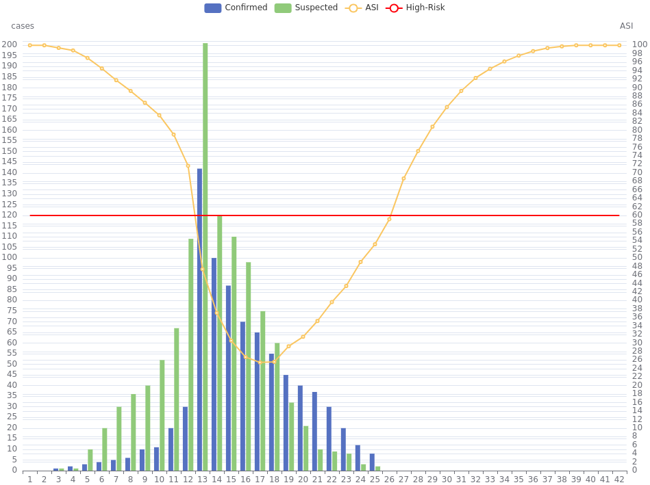
Experiments
Small Population
For a small population block, we assume the following conditions:
The population range is [500, 1000] in a block.
Pd =45 and Pw =15.
Large Population
For a large population block, we assume the following conditions:
The population range is [960000, 1000000] in a block.
Pd = 8000 and Pw = 4000.

Slide 11

System User Interface

Slide 12
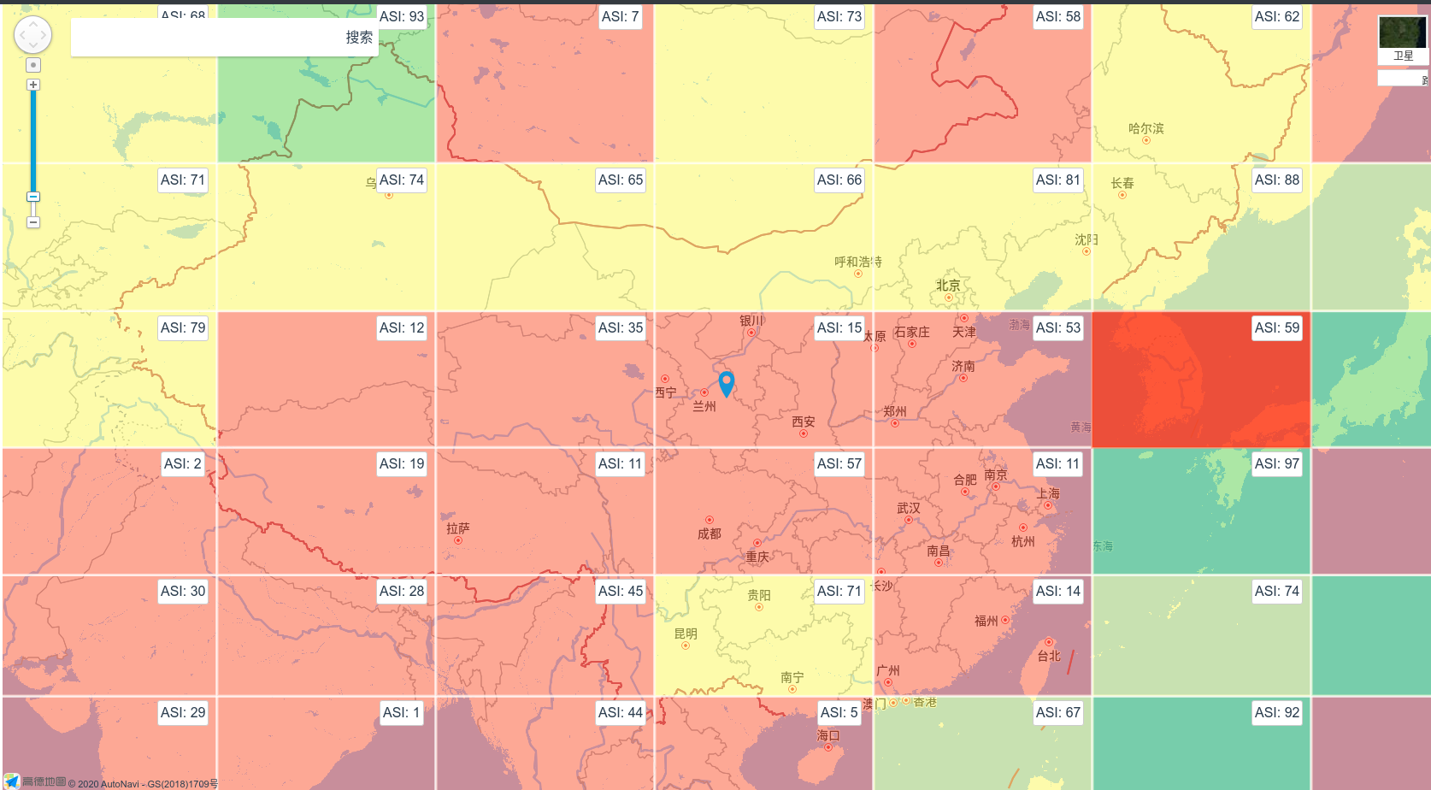
全国范围内疫情监测

Slide 13
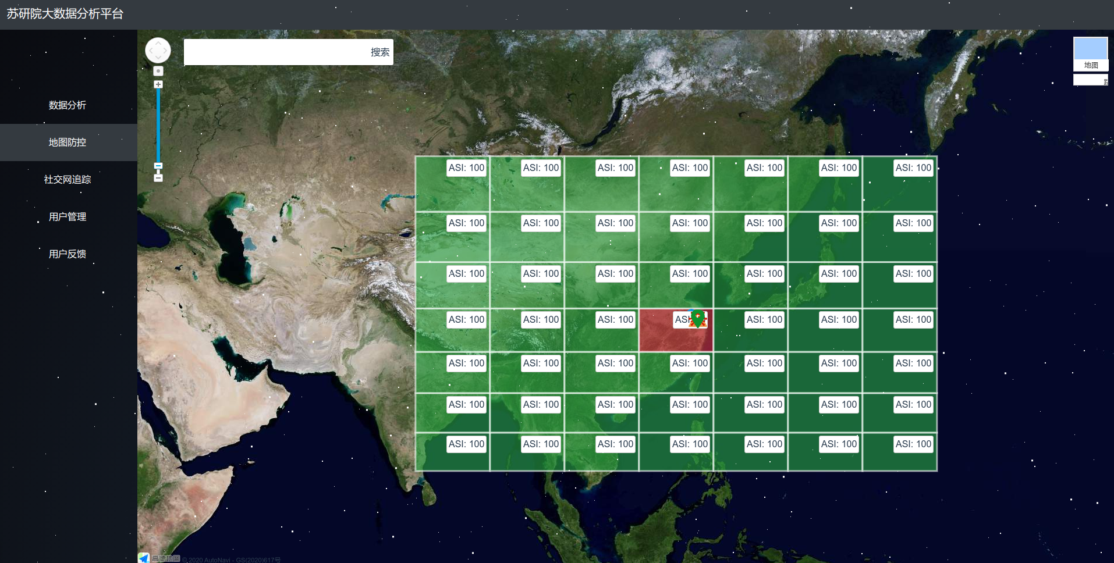
任意城市内疫情监测

Slide 14
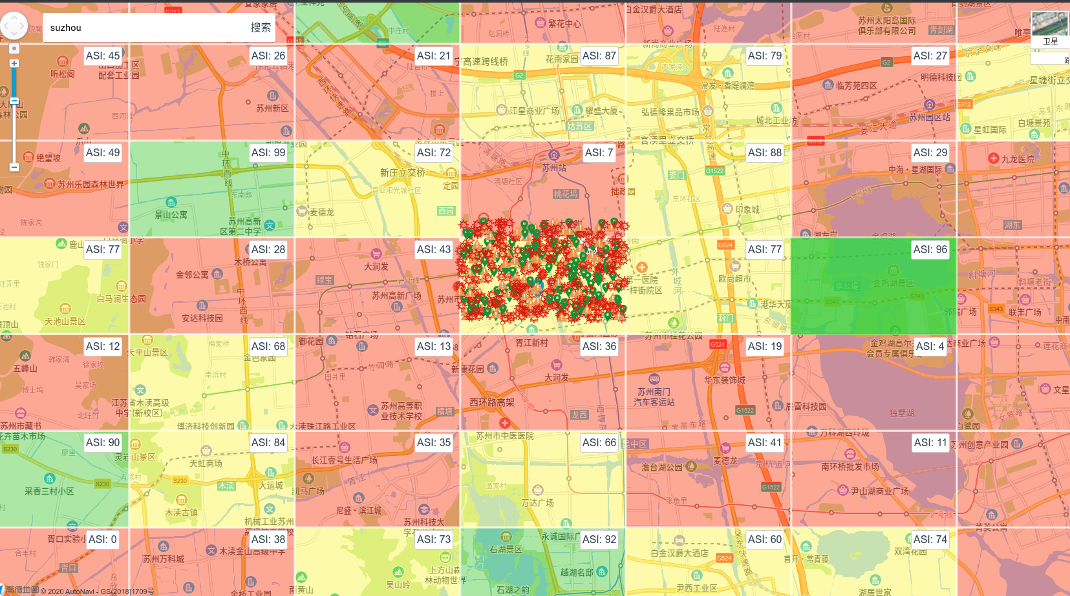

Slide 15
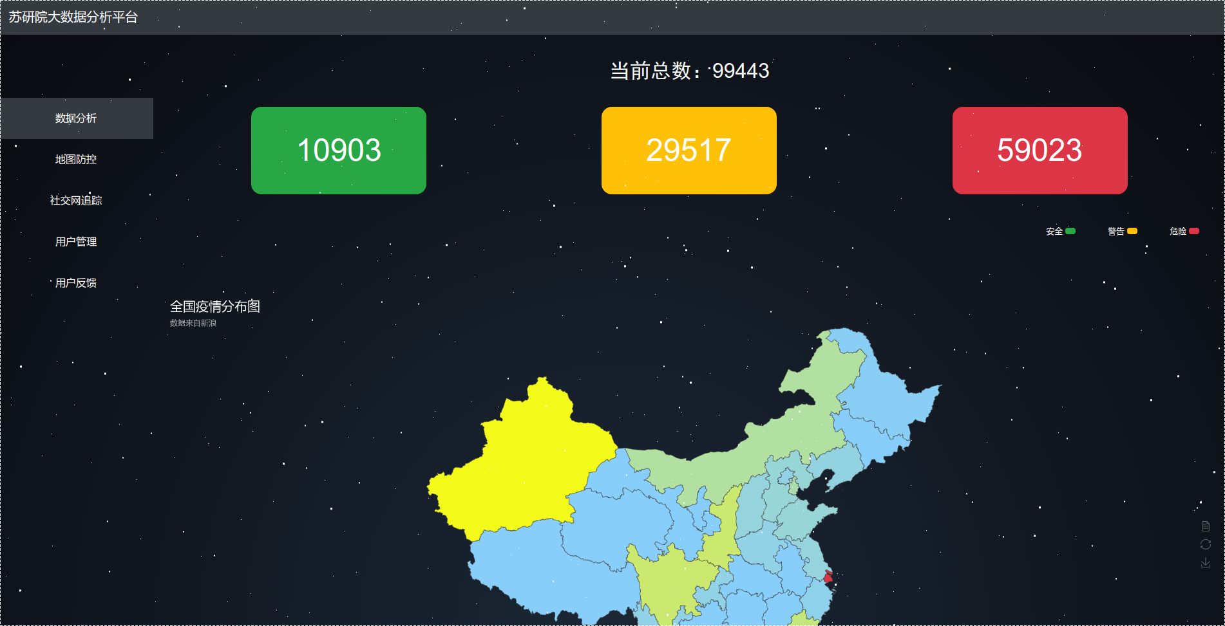

Slide 16
